Slide 1
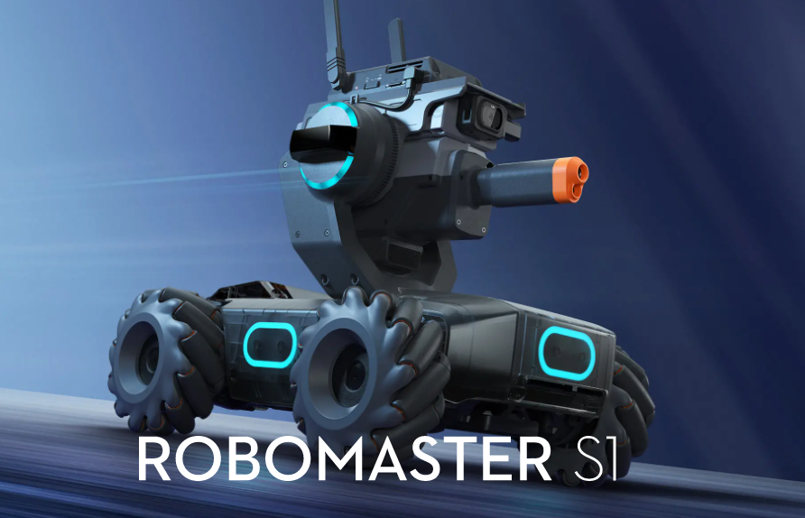

Slide 2
RoboMaster-S1
Final project in Autonomous Robots Course.
In this project we present the roboMaster system control and different abilities of the robot to perform autonomous tasks.
Amichai Kafka & Liav weiss & Omer Michael

Slide 3
RoboMaster-S1 Coordinate system
x
x
x
y
z
y
z
z
y
NED C.S
chassis C.S
Gimbal C.S

Slide 4
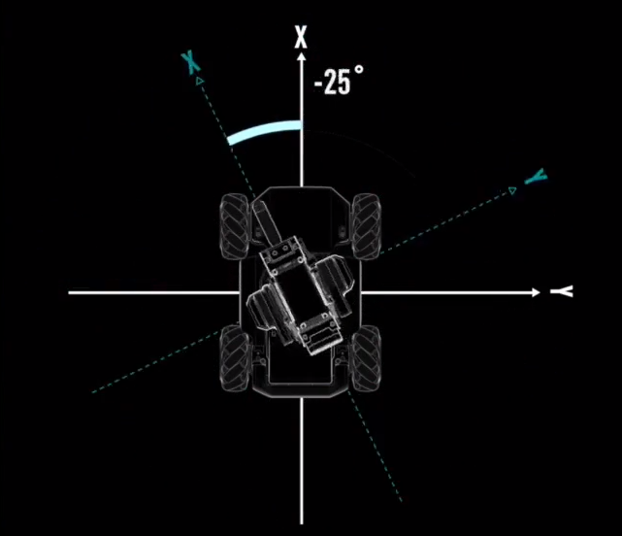
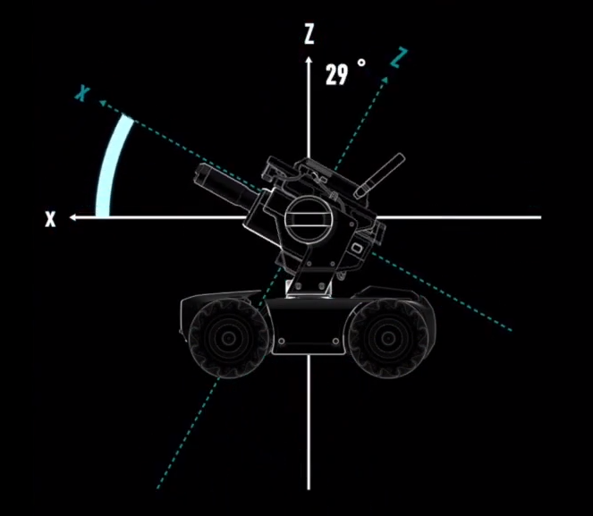
RoboMaster-S1 Coordinate system
When the gimbal rotates around the z axis of the gimbal C.S,
the x axis of the gimbal C.S and the x axis of the NED C.S
from an angle (-25) which is the yaw angle
When the gimbal rotates around the y axis of the gimbal C.S
the z axis of the gimbal C.S and the z axis of the NED C.S
from an angle (29) which is the pitch angle

Slide 5
RoboMaster-S1 Object detection
x
Error x = 0.5 - x
Error y = 0.5 - y
(0.5,0.5)
y

Slide 6
RoboMaster-S1
Abilities of the robot that we are going to display
Follow after line.
Follow and shot a person.
Detect and shot a marker
Follow and shot a robot.
Change light with simple claps hand.

Slide 7
Follow and shot a person.
In this part of the project we will present the robot's ability to track and shoot a person. First we want to control the chassis the and gimbal manual, after that we will Enable detection of persons. We will set the gimbal rotation speed to the maximum possible, for fast object. We will set the travel mode to free mode so we can automatically rotate the gimbal. To truck after the persom we will need to save his previous possitions and his current position. After that as long as we recognize the human we will track his location and shoot at him non-stop, as soon as the person comes out of the robot's mediator of vision the robot will stop and wait (to use as little battery of the robot as possible).
Video showing the 'Follow and shot a person’ ability:
https://youtube.com/shorts/ZHSRRkfaaq0?feature=share

Slide 8
Follow Line:
In this part of the project we will present the ability of the robot to follow a line. In this code the robot will follow a red line, but you can easily change the color of the line that the robot is following using line_follow_color_ located on line 30. First we lower the gimbal to look at the floor and after that as soon as the robot detects the red line it will move towards it, we have chosen the speed of the robot to be slower so that the robot can make sharp turns.
Video showing the 'Follow after line’ ability:
https://youtube.com/shorts/tX8VVClE-zo?feature=share

Slide 9
Detect and shot a marker
In this part of the project we will present the ability of the robot to search for a mark follow and shot him. First we want to rotate the gimbal to see if we recognize any marker, as soon as we see a certain marker we will save it and rotate the gimbal again until we recognize the same marker, as soon as we recognize the same marker we will make a slow move to it and shoot at it. It is important to note that if we see on the way another marker we will ignore it.
Video showing the ‘Detect and shot a marker' abillity:
https://youtube.com/shorts/ZrU5j08cnVE?feature=share

Slide 10
Follow and shot a robot.
In this part of the project we will present the robot's ability to track and shoot a robot. First we want to control the chassis the and gimbal manual, after that we will Enable detection of robot. We will set the gimbal rotation speed to the maximum possible, for fast object. We will set the travel mode to free mode so we can automatically rotate the gimbal. To truck after the robot we will need to save his previous possitions and his current position. After that as long as we recognize the robot we will track his location and shoot at him non-stop, as soon as the robot comes out of the robot's mediator of vision the robot will stop and wait (to use as little battery of the robot as possible).
Video showing the ‘Follow and shot a robot' ability:
https://youtube.com/shorts/uaK8NHYSVts

Slide 11
Change light with simple claps hand:
In this part of the project we will present the ability of the robot to change lighting with simple claps hand.
clap your hands two times- the robot will change his color light.
clap your hands three times - the robot will turn off his light.
Video showing the 'Change light with simple claps hand' ability:
https://youtube.com/shorts/pCJINt0g5TY?feature=share

